Slide 1
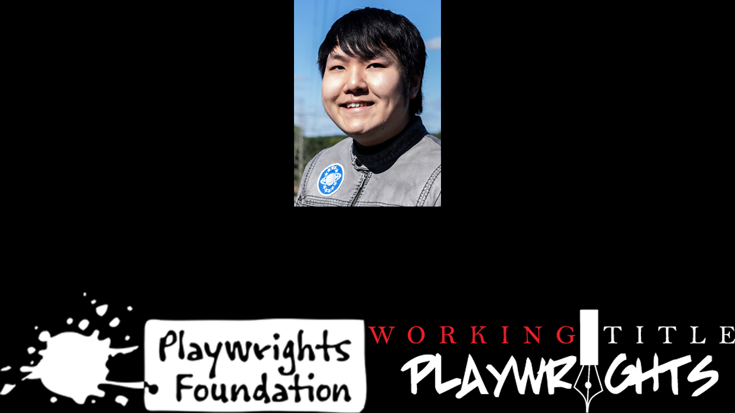
David Quang Pham
Literary Fellow
Musical Writer
…
Notes:
o David is a Vietnamese American who connects Eastern and Western art forms – this perspective contributes to his choices about story and music.
o David grew up listening to opera and has written a subatomic opera, a story about particles going to college, called TOUR, which was a 2020 Downtown Urban Arts Festival finalist. He is also the composer-lyricist on a musical called PARALLEL UNIVERSITY with two other collaborators for New York Public Library for the Performing Arts and their virtual reality program.
o David obtained his Bachelor of Science in Astrophysics and a Minor in Theatre from Michigan State University. During his sophomore year, he got a chance to studied under Dr. Andrea M. Ghez, 2020’s Nobel Prize in Physics laureate.
o He is a member of ASCAP, the Dramatists Guild, OPERA America, and ΣΠΣ, an honor society in physics. Further, David is the Literary Fellow for the Playwrights Foundation in San Francisco.
o David is a unique individual and has written a unique musical, a light opera, that incorporates the Big Bang, Gravity, Time, and Space in a story about family.
NEXT SLIDE

Slide 2
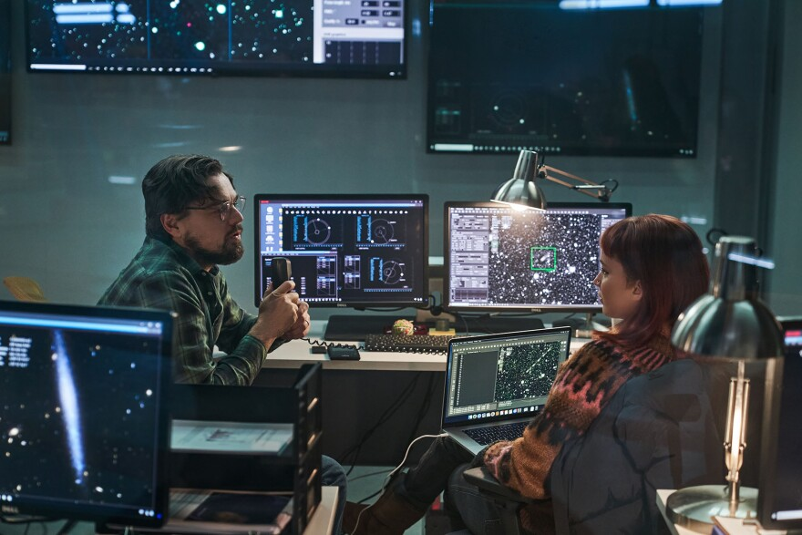
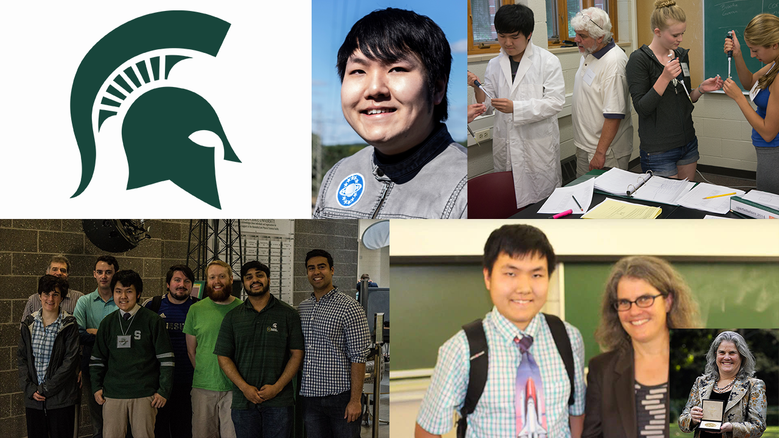
David Quang Pham
Literary Fellow
Musical Writer
Science Producer
Notes:
o David is a Vietnamese American who connects Eastern and Western art forms – this perspective contributes to his choices about story and music.
o David grew up listening to opera and has written a subatomic opera, a story about particles going to college, called TOUR, which was a 2020 Downtown Urban Arts Festival finalist. He is also the composer-lyricist on a musical called PARALLEL UNIVERSITY with two other collaborators for New York Public Library for the Performing Arts and their virtual reality program.
o David obtained his Bachelor of Science in Astrophysics and a Minor in Theatre from Michigan State University. During his sophomore year, he got a chance to studied under Dr. Andrea M. Ghez, 2020’s Nobel Prize in Physics laureate.
o He is a member of ASCAP, the Dramatists Guild, OPERA America, and ΣΠΣ, an honor society in physics. Further, David is the Literary Fellow for the Playwrights Foundation in San Francisco.
o David is a unique individual and has written a unique musical, a light opera, that incorporates the Big Bang, Gravity, Time, and Space in a story about family.
NEXT SLIDE

Slide 3
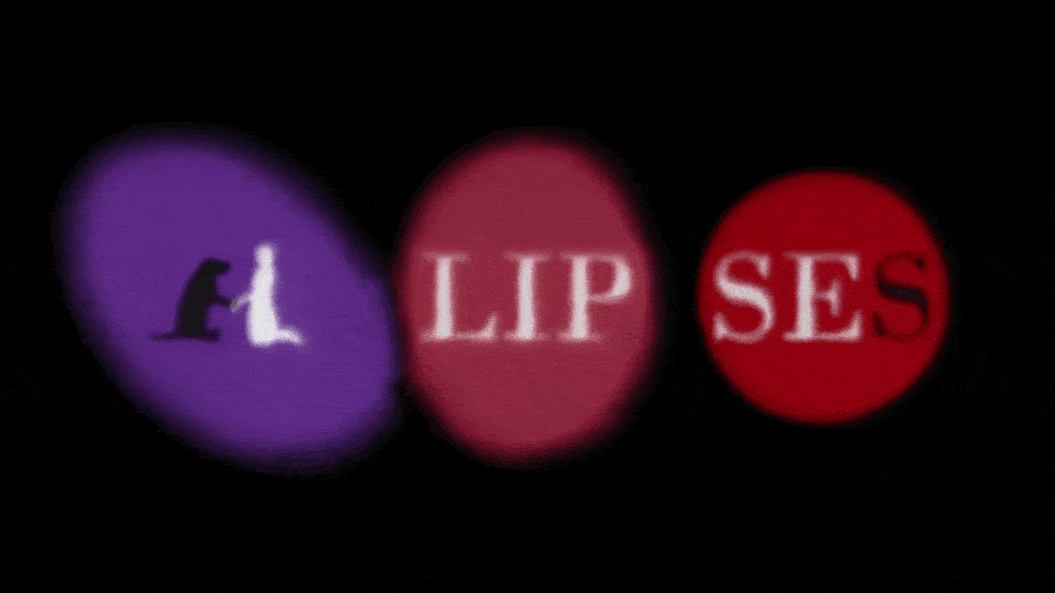
Notes:
Introduction
Good afternoon, everyone. I’m Kim Ruyle, and I’ve had the opportunity to review ELLIPSES, a new work of musical theatre... I’d like to share with you what excites me about this musical and what makes it so unique… CLICK to transition.
Play music clip.
CLICK to transition. ELLIPSES is by David Pham, and I believe it represents a unique opportunity for producers and the theatre community in general. In the next few minutes, I will tell you what drew me to ELLIPSES and share what I believe makes it so unique. I hope to answer why you, as a producer, should consider this opportunity… why this play… why this playwright… and why now.
Next slide.

Slide 4


Book, Music, & Lyrics by
David Quang Pham
davidquangpham@outlook.com
ellipsesplay.com @EllipsesPlay
Notes:
Introduction
Good afternoon, everyone. I’m Kim Ruyle, and I’ve had the opportunity to review ELLIPSES, a new work of musical theatre... I’d like to share with you what excites me about this musical and what makes it so unique… CLICK to transition.
Play music clip.
CLICK to transition. ELLIPSES is by David Pham, and I believe it represents a unique opportunity for producers and the theatre community in general. In the next few minutes, I will tell you what drew me to ELLIPSES and share what I believe makes it so unique. I hope to answer why you, as a producer, should consider this opportunity… why this play… why this playwright… and why now.
Next slide.

Slide 5
A Universal Musical
This family drama of epic proportions centers on the Galaxy family and their dog Gravity as they face a life-changing event known as the Big Bang. The hero of the story unleashes the Big Bang in order to run away from home.
Book, Music, & Lyrics by
David Quang Pham
davidquangpham@outlook.com
ellipsesplay.com @EllipsesPlay
Notes:
o August 2020 — July 2021: Working Title Playwrights New Play Development and Dramaturgy Apprenticeship
o October 2020 – May 2021: Multiple Readings with Talkback
o July 2021: Concert Reading with Talkback directed by Aliyah Curry
o June 2021 — Ongoing: Theater Resources Unlimited Workshops
o June 2021: How to Write a Musical That Works – Part One: The World & the Want Workshop
o October 2021: How to Write a Musical That Works – Part Two: Conflict & Obstacles Workshop
o In the coming days, David and Daniela Cobb, the actress who has been portraying his protagonist and a Broadway performer on The Lion King, are speakers at the Durban University of Technology’s Annual Research Conference. This university in South Africa has been showcasing their songs to their Faculty of Arts and Design throughout the past summer.
NEXT SLIDE

Slide 6

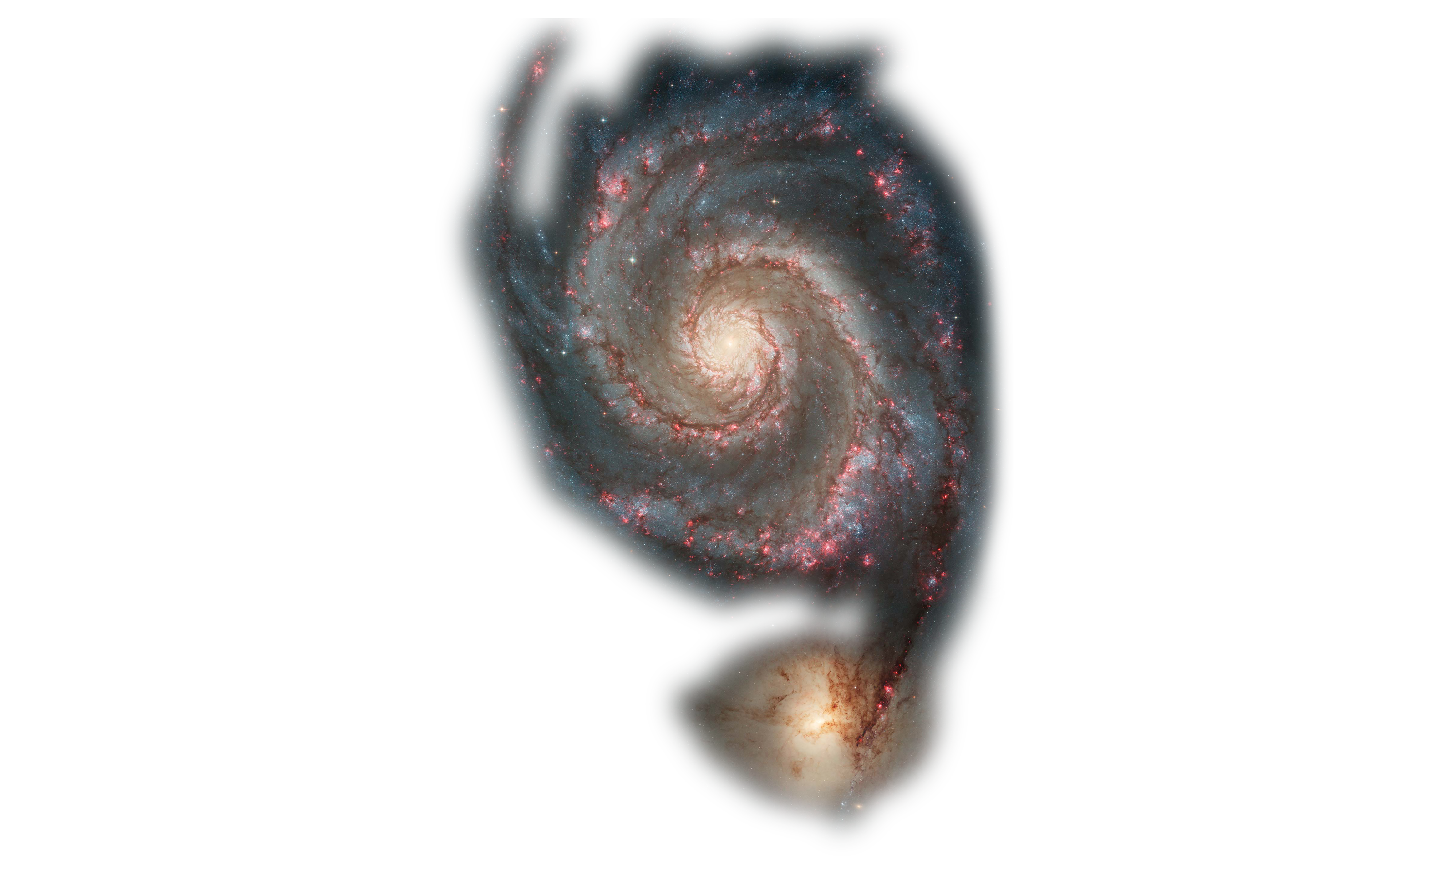
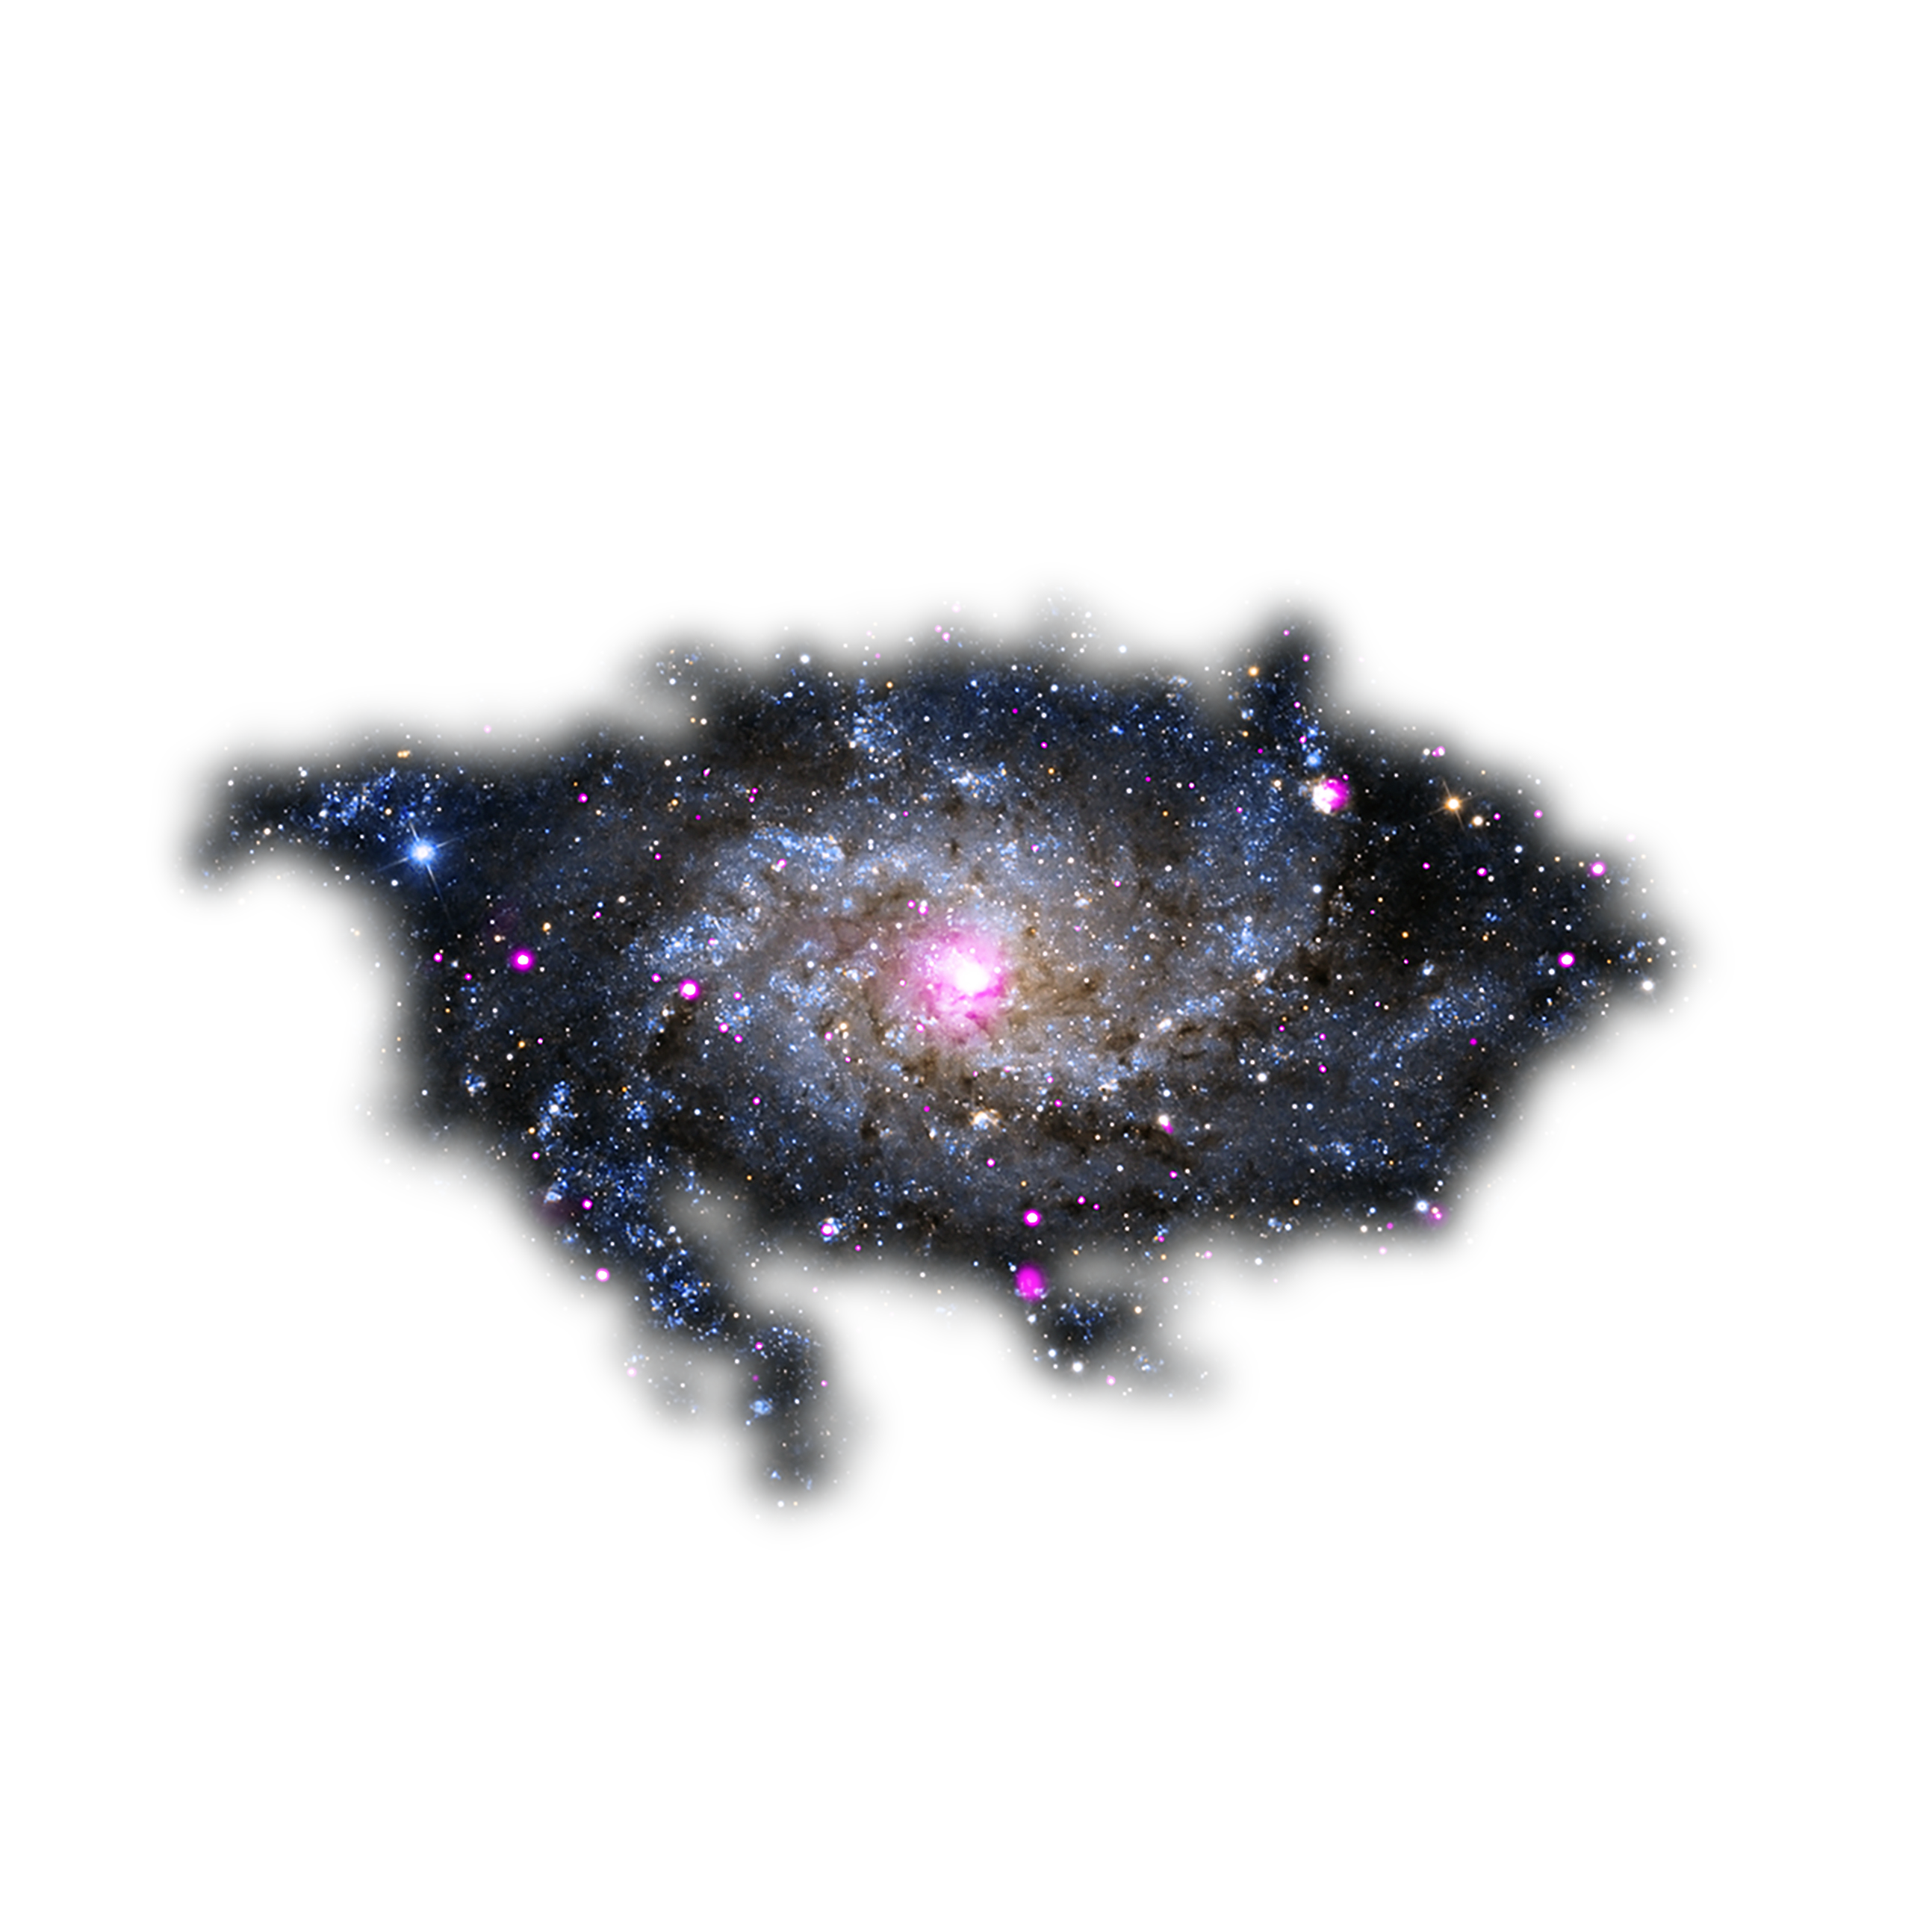
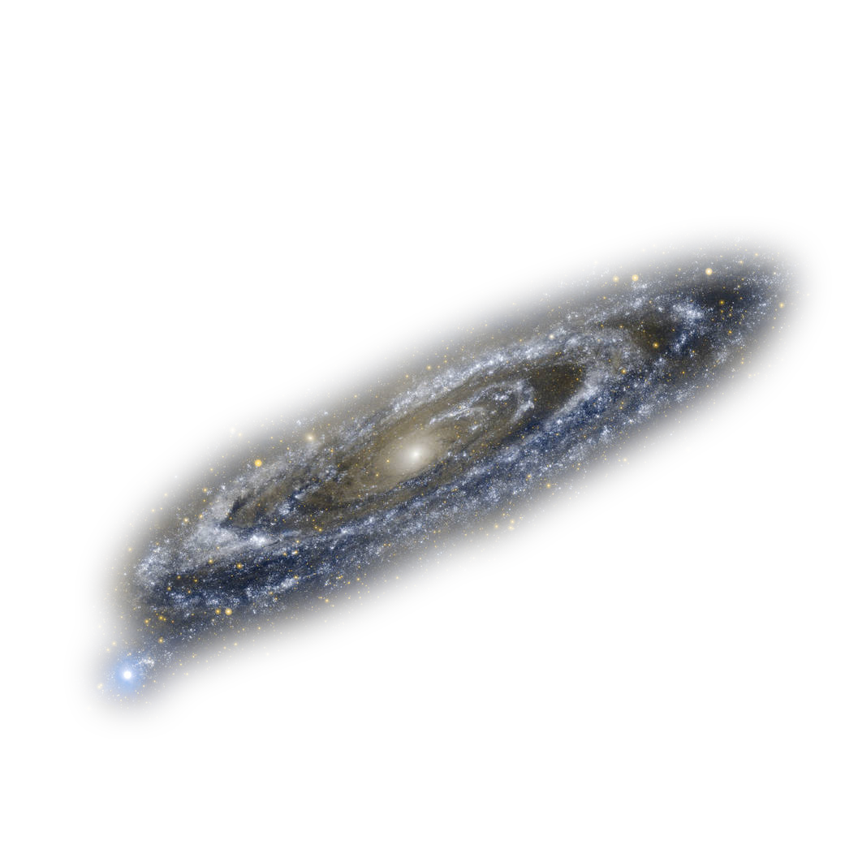
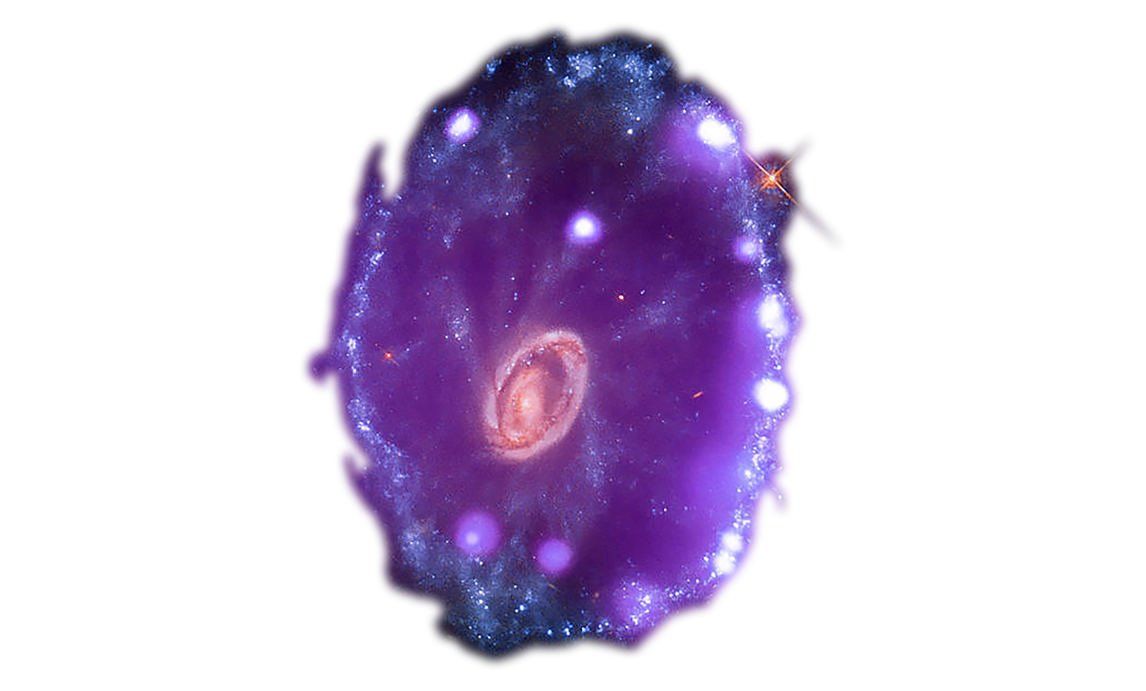
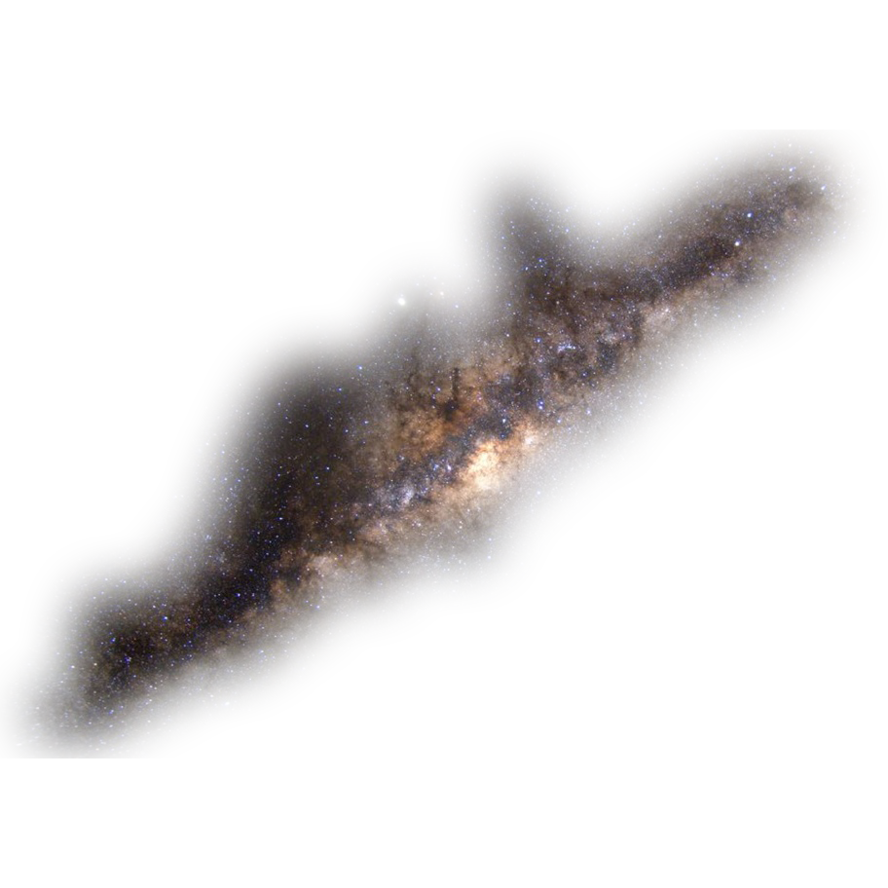
Cast
o 8 Principal Characters (The Galaxy Family)
o Singularity, the single parent of six Galaxies
o 6 Galaxies (JD, Cartwheel, Whirlpool, Triangulum, Andromeda, Milky Way)
o Gravity, the family dog
o Flexible Ensemble (Dogs, Solar System Objects)
Book, Music, & Lyrics by
David Quang Pham
davidquangpham@outlook.com
ellipsesplay.com @EllipsesPlay
Notes:
o August 2020 — July 2021: Working Title Playwrights New Play Development and Dramaturgy Apprenticeship
o October 2020 – May 2021: Multiple Readings with Talkback
o July 2021: Concert Reading with Talkback directed by Aliyah Curry
o June 2021 — Ongoing: Theater Resources Unlimited Workshops
o June 2021: How to Write a Musical That Works – Part One: The World & the Want Workshop
o October 2021: How to Write a Musical That Works – Part Two: Conflict & Obstacles Workshop
o In the coming days, David and Daniela Cobb, the actress who has been portraying his protagonist and a Broadway performer on The Lion King, are speakers at the Durban University of Technology’s Annual Research Conference. This university in South Africa has been showcasing their songs to their Faculty of Arts and Design throughout the past summer.
NEXT SLIDE

Slide 7
Music (POPERA)
o Pop o Chinese Opera o Punk o Psychedelia
“The music is a character in its own right… feels like it was written before time existed.”
- Zeniba Now, Award-Winning Musical Writer & Art Scientist
“I compare it to American Idiot through the lens of Katamari Damacy.”
- Liz Dooley, Dramaturg & Playwright
Book, Music, & Lyrics by
David Quang Pham
davidquangpham@outlook.com
ellipsesplay.com @EllipsesPlay
Notes:
o August 2020 — July 2021: Working Title Playwrights New Play Development and Dramaturgy Apprenticeship
o October 2020 – May 2021: Multiple Readings with Talkback
o July 2021: Concert Reading with Talkback directed by Aliyah Curry
o June 2021 — Ongoing: Theater Resources Unlimited Workshops
o June 2021: How to Write a Musical That Works – Part One: The World & the Want Workshop
o October 2021: How to Write a Musical That Works – Part Two: Conflict & Obstacles Workshop
o In the coming days, David and Daniela Cobb, the actress who has been portraying his protagonist and a Broadway performer on The Lion King, are speakers at the Durban University of Technology’s Annual Research Conference. This university in South Africa has been showcasing their songs to their Faculty of Arts and Design throughout the past summer.
NEXT SLIDE

Slide 8
What is an ellipse…? What are ellipses…?
Geometry Lesson! Grammar Lesson!
…
Book, Music, & Lyrics by
David Quang Pham
davidquangpham@outlook.com
ellipsesplay.com @EllipsesPlay
Notes:
o August 2020 — July 2021: Working Title Playwrights New Play Development and Dramaturgy Apprenticeship
o October 2020 – May 2021: Multiple Readings with Talkback
o July 2021: Concert Reading with Talkback directed by Aliyah Curry
o June 2021 — Ongoing: Theater Resources Unlimited Workshops
o June 2021: How to Write a Musical That Works – Part One: The World & the Want Workshop
o October 2021: How to Write a Musical That Works – Part Two: Conflict & Obstacles Workshop
o In the coming days, David and Daniela Cobb, the actress who has been portraying his protagonist and a Broadway performer on The Lion King, are speakers at the Durban University of Technology’s Annual Research Conference. This university in South Africa has been showcasing their songs to their Faculty of Arts and Design throughout the past summer.
NEXT SLIDE

Slide 9
An Elliptical Message
What does nothingness do for someone?
“Nothing” leaves space for “Everything.”
“Nothing” makes room for “Everything.”
Key: Family is Everything (you know).
Book, Music, & Lyrics by
David Quang Pham
davidquangpham@outlook.com
ellipsesplay.com @EllipsesPlay
Notes:
o August 2020 — July 2021: Working Title Playwrights New Play Development and Dramaturgy Apprenticeship
o October 2020 – May 2021: Multiple Readings with Talkback
o July 2021: Concert Reading with Talkback directed by Aliyah Curry
o June 2021 — Ongoing: Theater Resources Unlimited Workshops
o June 2021: How to Write a Musical That Works – Part One: The World & the Want Workshop
o October 2021: How to Write a Musical That Works – Part Two: Conflict & Obstacles Workshop
o In the coming days, David and Daniela Cobb, the actress who has been portraying his protagonist and a Broadway performer on The Lion King, are speakers at the Durban University of Technology’s Annual Research Conference. This university in South Africa has been showcasing their songs to their Faculty of Arts and Design throughout the past summer.
NEXT SLIDE

Slide 10
Entangling this with the Science!
The world needs stories about the importance of connections while embracing science. Science is more important than ever before; there are people who do not believe in science. Perhaps, it is because scientific principles are not represented in human qualities. David’s use of personification in a narrative format looks to bridge humanity and galaxies.
Book, Music, & Lyrics by
David Quang Pham
davidquangpham@outlook.com
ellipsesplay.com @EllipsesPlay
Notes:
o August 2020 — July 2021: Working Title Playwrights New Play Development and Dramaturgy Apprenticeship
o October 2020 – May 2021: Multiple Readings with Talkback
o July 2021: Concert Reading with Talkback directed by Aliyah Curry
o June 2021 — Ongoing: Theater Resources Unlimited Workshops
o June 2021: How to Write a Musical That Works – Part One: The World & the Want Workshop
o October 2021: How to Write a Musical That Works – Part Two: Conflict & Obstacles Workshop
o In the coming days, David and Daniela Cobb, the actress who has been portraying his protagonist and a Broadway performer on The Lion King, are speakers at the Durban University of Technology’s Annual Research Conference. This university in South Africa has been showcasing their songs to their Faculty of Arts and Design throughout the past summer.
NEXT SLIDE

Slide 11


Development
o 2020-21: Working Title Playwrights Apprenticeship
o 4 Readings with Talkback
o July 2021: Concert Reading with Talkback
o 2021: Theater Resources Unlimited
o 2 Musical Workshops
o December 2021: Director Lab
Book, Music, & Lyrics by
David Quang Pham
davidquangpham@outlook.com
ellipsesplay.com @EllipsesPlay
Notes:
o August 2020 — July 2021: Working Title Playwrights New Play Development and Dramaturgy Apprenticeship
o October 2020 – May 2021: Multiple Readings with Talkback
o July 2021: Concert Reading with Talkback directed by Aliyah Curry
o June 2021 — Ongoing: Theater Resources Unlimited Workshops
o June 2021: How to Write a Musical That Works – Part One: The World & the Want Workshop
o October 2021: How to Write a Musical That Works – Part Two: Conflict & Obstacles Workshop
o In the coming days, David and Daniela Cobb, the actress who has been portraying his protagonist and a Broadway performer on The Lion King, are speakers at the Durban University of Technology’s Annual Research Conference. This university in South Africa has been showcasing their songs to their Faculty of Arts and Design throughout the past summer.
NEXT SLIDE

Slide 12

Next Steps
o Apply for more developmental programs
o ELLIPSES is a current 2022 O’Neill Semifinalist
o Development in the collegiate circuit
o Looking to connect with universities’ theatre and astronomy departments
Book, Music, & Lyrics by
David Quang Pham
davidquangpham@outlook.com
ellipsesplay.com @EllipsesPlay
Notes:
o August 2020 — July 2021: Working Title Playwrights New Play Development and Dramaturgy Apprenticeship
o October 2020 – May 2021: Multiple Readings with Talkback
o July 2021: Concert Reading with Talkback directed by Aliyah Curry
o June 2021 — Ongoing: Theater Resources Unlimited Workshops
o June 2021: How to Write a Musical That Works – Part One: The World & the Want Workshop
o October 2021: How to Write a Musical That Works – Part Two: Conflict & Obstacles Workshop
o In the coming days, David and Daniela Cobb, the actress who has been portraying his protagonist and a Broadway performer on The Lion King, are speakers at the Durban University of Technology’s Annual Research Conference. This university in South Africa has been showcasing their songs to their Faculty of Arts and Design throughout the past summer.
NEXT SLIDE

Slide 13
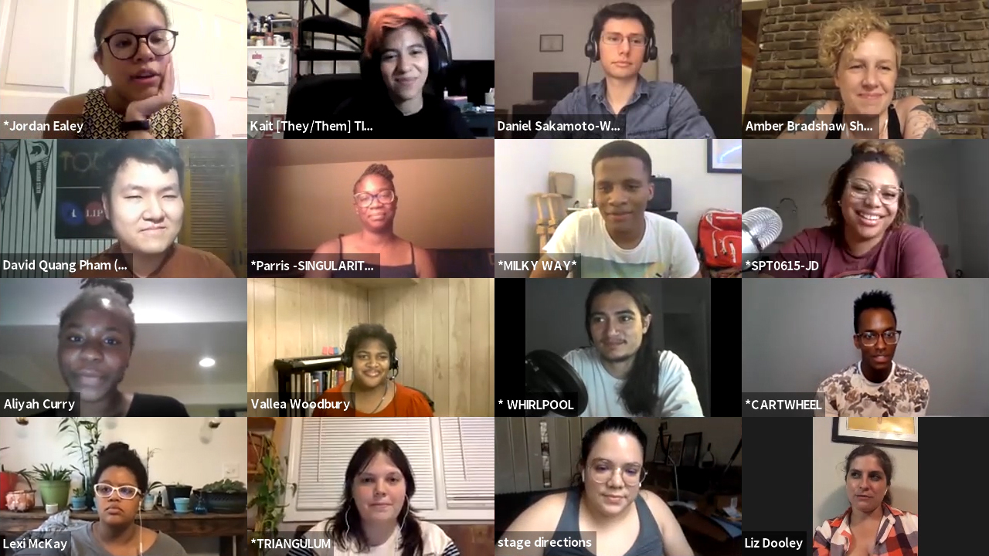
Book, Music, & Lyrics by
David Quang Pham
davidquangpham@outlook.com
ellipsesplay.com @EllipsesPlay
Notes:
About the Musical
The theatrical reading that I viewed had a very young, energetic, talented, and diverse cast
Instrumentation might be as simple as a piano, guitar, bass guitar, and drum kit
There’s also diversity in the music which ranges from operatic to pop to metal to experimental
NEXT SLIDE

Slide 14
Unique!
“I absolutely love this idea. The idea about a universe that’s a family drama… How incredible is that… It’s very unique and very original.”
- Paul Gordon, Composer/Lyricist of Jane Eyre and Daddy Long Legs
“I love stories about families and this is truly the most unique I've seen.”
- John Mabey, Award-Winning Playwright
Book, Music, & Lyrics by
David Quang Pham
davidquangpham@outlook.com
ellipsesplay.com @EllipsesPlay
Notes:
o August 2020 — July 2021: Working Title Playwrights New Play Development and Dramaturgy Apprenticeship
o October 2020 – May 2021: Multiple Readings with Talkback
o July 2021: Concert Reading with Talkback directed by Aliyah Curry
o June 2021 — Ongoing: Theater Resources Unlimited Workshops
o June 2021: How to Write a Musical That Works – Part One: The World & the Want Workshop
o October 2021: How to Write a Musical That Works – Part Two: Conflict & Obstacles Workshop
o In the coming days, David and Daniela Cobb, the actress who has been portraying his protagonist and a Broadway performer on The Lion King, are speakers at the Durban University of Technology’s Annual Research Conference. This university in South Africa has been showcasing their songs to their Faculty of Arts and Design throughout the past summer.
NEXT SLIDE

